Slide 1
Singular Value Decomposition
Vincent Guillemot

Slide 2
Some mental images

Slide 3
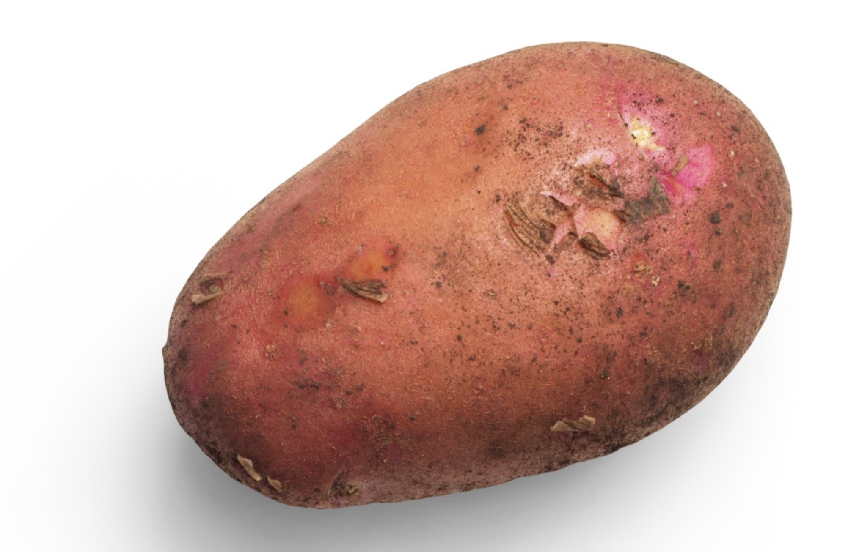
Potato Chips Analysis
Cut the yummiest French fries

Slide 4

Whale versus krill: this is you (credit: Allison Horst)
Eat the most krill (put on your 3D glasses)

Slide 5
Artwork by @allison_horst

Slide 6

Whale versus krill: this is your data (credit: Allison Horst)
Eat the most krill (put on your 3D glasses)

Slide 7
Artwork by @allison_horst

Slide 8
The tri-force of PCA

Slide 9
Beautiful illustration
Screeplot, versus individual map, versus circle of correlation. With the associated theoretical concepts: inertia (multivariate variance), distance between individuals, and angles between

Slide 10
Example data
xtmp <- readxl::read_excel("../data/simul.xlsx") x <- as.matrix(xtmp[, -1]) rownames(x) <- xtmp$Ind

Slide 11
Example screeplot

Slide 12
Example individual map

Slide 13
Example circle of correlation

Slide 14
Vocabulary

Slide 15
French versus English
English | French
PCA = principal component analysis | ACP = analyse en composantes principales
SVD = singular value decomposition | SVD = décomposition en valeurs singulières
EVD = eigenvalue decomposition | décomposition en éléments propres
ICA = independent component analysis | ICA = analyse en composantes indépendantes
MDS = multidimensional scaling | MDS = multidimensional scaling
“Aaaaah, mais ACP en fait c’est la PCA !”
(Anonymous student, after 6 hours of teaching PCA in French)

Slide 16
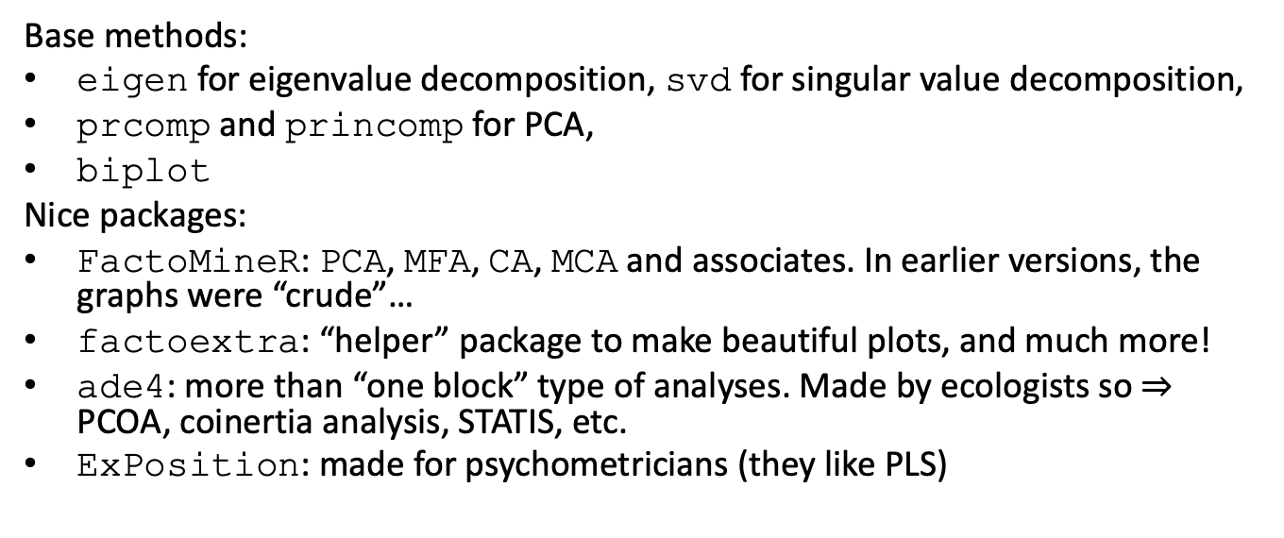
R vocabulary
Base methods:
eigen for eigenvalue decomposition, svd for singular value decomposition,
prcomp and princomp for PCA,
biplot
Nice packages:
FactoMineR: PCA, MFA, CA, MCA and associates. In earlier versions, the graphs were “crude”…
factoextra: “helper” package to make beautiful plots, and much more!
ade4: more than “one block” type of analyses. Made by ecologists so $⇒$ PCOA, coinertia analysis, STATIS, etc.
ExPosition: made for psychometricians (they like PLS)

Slide 17
And a few nice books and papers
books and papers

Slide 18
A little bit of Math

Slide 19
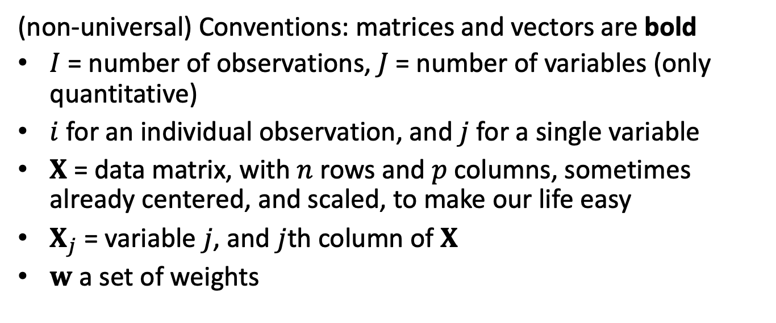
Notations
(non-universal) Conventions: matrices and vectors are bold
$I$ = number of observations, $J$ = number of variables (only quantitative)
$i$ for an individual observation, and $j$ for a single variable
$X$ = data matrix, with $n$ rows and $p$ columns, sometimes already centered, and scaled, to make our life easy
$X_{j}$ = variable $j$, and $j$th column of $X$
$w$ a set of weights

Slide 20
A little detour: matrix multiplication
Take a pen and paper, and do this multiplication:
$$\left[\begin{matrix}1 & −1 \\ 0 & 1 \\ 2 & 1\end{matrix}\right]×\left[\begin{matrix}1 & 2 & 3 & 4 \\ −1 & 0 & 0 & 1\end{matrix}\right]$$
Cool video: 5 ways to see matrix multiplication

Slide 21
PCA
“Find a linear combination of the columns of the data that would capture the most information.”
In mathematical words, find
$$Xw=w_{1}X_{1}+⋯+w_{p}X_{p}$$
that maximizes… wait a minute! What are the dimensions?
$X$: $I$ rows and $J$ columns,
$w$: $J$ rows and $1$ columns,
$Xw$: $I$ rows and $1$ column.

Slide 22
The mathematical translation of the intuitions behind PCA

Slide 23
Most popular intuition of PCA: how does it translate?
“PCA creates a linear combination of variables that maximizes variance.”
$$arg\max_{∥w∥_{2}^{2}=1}\text{var}\left(Xw\right)$$
Why $∥w∥_{2}=1$?
Dirty trick: $\text{var}\left(Xw\right)=w^{⊤}X^{⊤}Xw$

Slide 24
Least “well-known” intuition of PCA: how does it translate?
“PCA creates a linear combination of variables that maximizes correlation.”
$$arg\max_{w}\sum_{j=1}^{p}{\text{cor}}{\left(Xw,X_{j}\right)}^{2}$$

Slide 25
Second least “well-known” intuition of PCA: how does it translate?
“PCA creates the best lower rank approximation of the covariance matrix.”
$$arg\min_{∥w∥_{2}^{2}=1}{∥\frac{1}{n}X^{⊤}X−λww^{⊤}∥}_{F}^{2}$$
$\frac{1}{n}X^{⊤}X$
$λ$: the [blank] of the covariance matrix
$w$: the [blank] of the covariance matrix

Slide 26
A little image

Slide 27
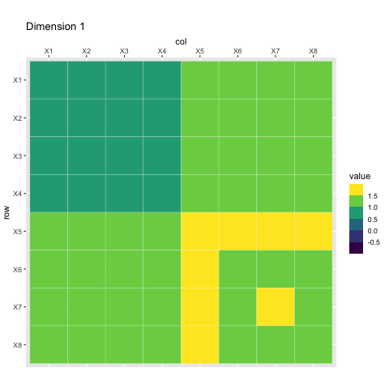
Rank-1 approximations

Slide 28
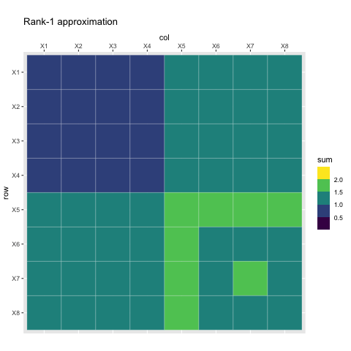
Increasing rank approximations

Slide 29
We can do the same kind of magic with the data itself
Singular value decomposition can be used to approximate a rectangular matrix with a lower ranked matrix of the same dimension
$$arg\min_{∥u∥_{2}^{2}=∥w∥_{2}^{2}=1}{∥X−δuw^{⊤}∥}_{F}^{2}$$
$δ$: singular value
$u$: left singular vector
$w$: right singular vector

Slide 30
Rank 1 approximation

Slide 31
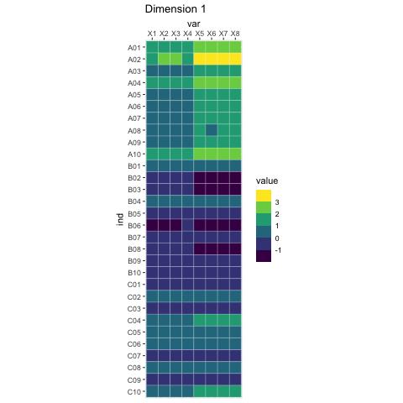
Rank-1 approximations

Slide 32
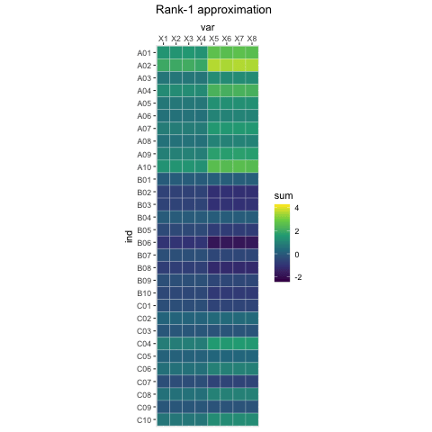
Increasing rank approximations

Slide 33
Constraining the SVD

Slide 34
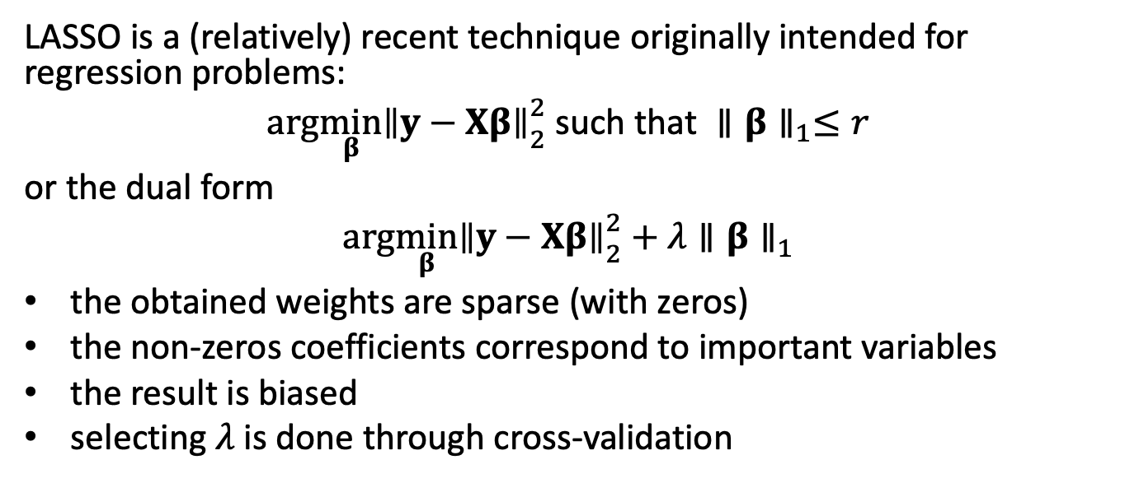
LASSO
LASSO is a (relatively) recent technique originally intended for regression problems:
$$arg\min_{β}{∥y−Xβ∥}_{2}^{2} \text{such} \text{that} ∥β∥_{1}≤r$$
or the dual form
$$arg\min_{β}{∥y−Xβ∥}_{2}^{2}+λ∥β∥_{1}$$
the obtained weights are sparse (with zeros)
the non-zeros coefficients correspond to important variables
the result is biased
selecting $λ$ is done through cross-validation

Slide 35
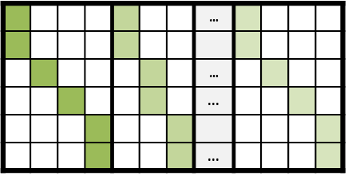
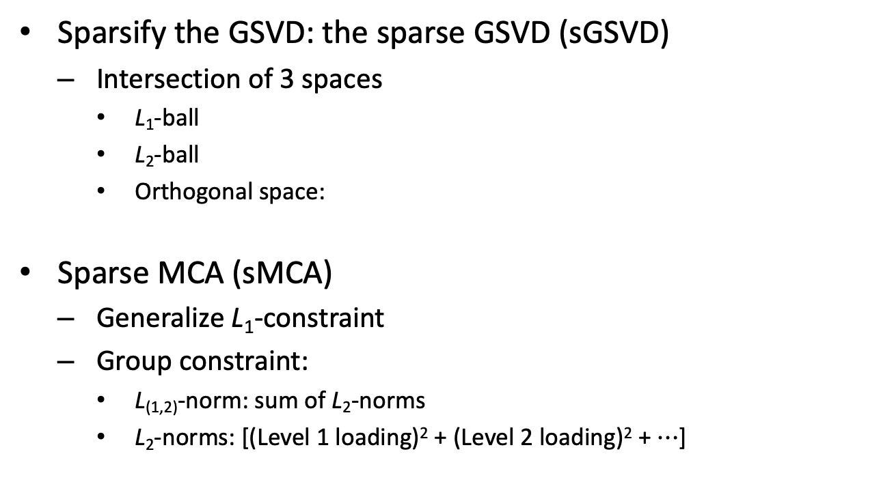
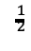
Sparse GSVD (sGSVD) and sparse MCA (sMCA)
Sparsify the GSVD: the sparse GSVD (sGSVD)
Intersection of 3 spaces
L₁-ball
L₂-ball
Orthogonal space:
Sparse MCA (sMCA)
Generalize L₁-constraint
Group constraint:
L_{(1,2)}-norm: sum of L₂-norms
L₂-norms: [(Level 1 loading)² + (Level 2 loading)² + $⋯$]
with weights P^{T}W_{X}P = I
P⊥
W_{X}P⊥
$$^{\frac{1}{2}}$$
P
one loading
W_{X}P
Notes:
Generalized the L1 constraint by including the L2 norms of the variables and imposing constraints on the L12 norm.
Set a limit for the norm which becomes the L1 norm of these L2 norms.
The L2 norms here are the sq of SS of all loadings that belong to the same variable.
With this new constraints, we sparsify a group of loadings at the same time.

Slide 36
Optimization problem
$$\begin{matrix}\left(δ_{ℓ},p_{ℓ},q_{ℓ}\right)=arg\min_{β}{∥X−δp^{⊤}q∥}_{2}^{2} \\ \text{such} \text{that} \left\{\begin{matrix}p^{⊤}Mp=q^{⊤}Wq=1 \\ p^{⊤}Mp_{ℓ^{′}}=q^{⊤}Wq_{ℓ^{′}}=0,∀ℓ^{′}<ℓ \\ ∥p∥_{1}≤s_{p,ℓ} \text{and} ∥q∥_{1}≤s_{q,ℓ}\end{matrix}\right.\end{matrix}$$

Slide 37
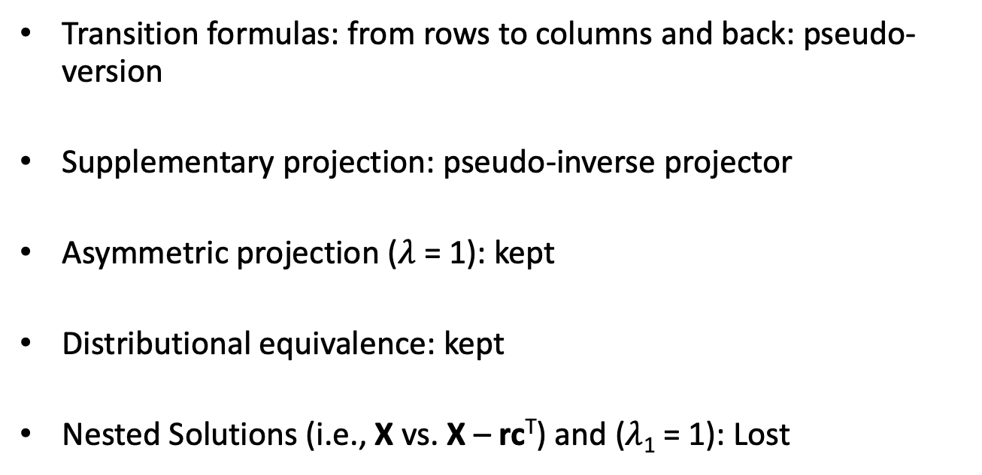
Lost & Found
Transition formulas: from rows to columns and back: pseudo-version
Supplementary projection: pseudo-inverse projector
Asymmetric projection ($λ$ = 1): kept
Distributional equivalence: kept
Nested Solutions (i.e., X vs. X – rc^{T}) and ($λ$₁ = 1): Lost

Slide 38
What are the parameters?
$M$ and $W$ = masses, weights… so metrics
$s_{p,ℓ}$ and $s_{q,ℓ}$ = sparsity parameters, between 1 (strong sparsity), and $\sqrt{\text{dimension}}$ (no sparsity)

